Slide 1


Validation and Evaluation of HyStart++ for Linux
Maryam Ataei Kachooei
Clive Thompson
Zimraan Ahmad
Joshua Solomon
Mark Claypool
15 July, 2026
Jae Chung
Feng Li
Benjamin Peters

Slide 2
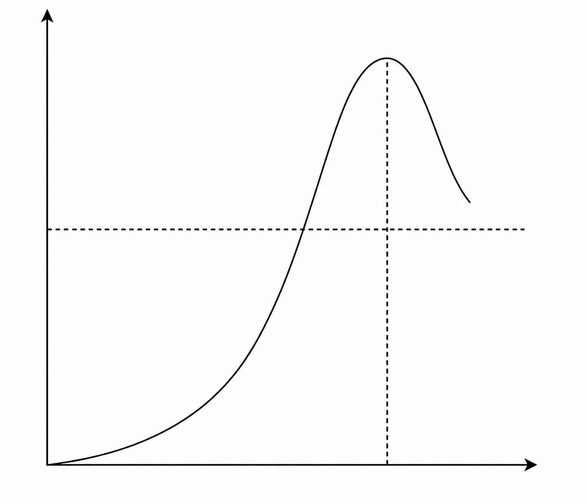
TCP Slow Start
Goal:
quickly discover available capacity.
TCP congestion window approximately doubles for each RTT
Slow start
Loss
Problem:
exponential growth can overshoot.
Need a signal to exit slow start
cwnd
BDP
Traditional TCP
Loss
Too late
HyStart
RTT & Ack behavior
Linux default
Limitation
RTT variation can look like congestion
Time
Too Early

Slide 3
HyStart++
Conservative slow start (CSS):
Growth is reduced, not stopped
Exit slow start
Enter congestion avoidance
HyStart
slow start
delay signal
congestion avoidance
Possible delay signal
delay signal confirmed
HyStart++
slow start
conservative slow start (CSS)
congestion avoidance
Wrong signal
IETF RFC 9406, HyStart++: Modified Slow Start for TCP, May 2023.

Slide 4
Paper Roadmap
1. RFC Flowchart
What HyStart++ is intended to do
2. Linux Paths
Where that behavior appears
3. Validation Summary
Match
4. Evaluation
Controlled + GEO testbeds
5. Conclusion and future works

Slide 5
HyStart++ RFC (9406)
No
Loss/ECN
Check for end of round
SS or CSS?
HyStart++ initialization
ACK arrives
No
Yes
Start new round
Slow Start
CSS
Yes
SS
CSS
CA
Enter CA
Update cwnd and minRTT
Update cwnd and minRTT
Common
Check for delay-increase preconditions
Check for CSS sample requirement
No
Yes
Yes
No
Check for CSS completion
Check for spurious slow start exit
No
Compute delay threshold
Yes
Check for delay increase
No
Remain in slow start
No
Yes
Exit slow start and enter CSS
Yes
Remian in CSS
Resume slow start

Slide 6
Paper Roadmap
1. RFC Flowchart
What HyStart++ is intended to do
2. Linux Paths
Where that behavior appears
3. Validation Summary
Match
4. Evaluation
Controlled + GEO testbeds
5. Conclusion and future works

Slide 7
Linux Implementation
cubictcp_acked()
cubictcp_init()
Check for congestion response
Yes
No
cubictcp_recalc_ssthresh()
cubictcp_cong_avoid()
cubictcp_state()
M. Arghavani, HyStartPP: Modified Linux CUBIC Implementation, GitHub, commit c0a089e, 2025.

Slide 8
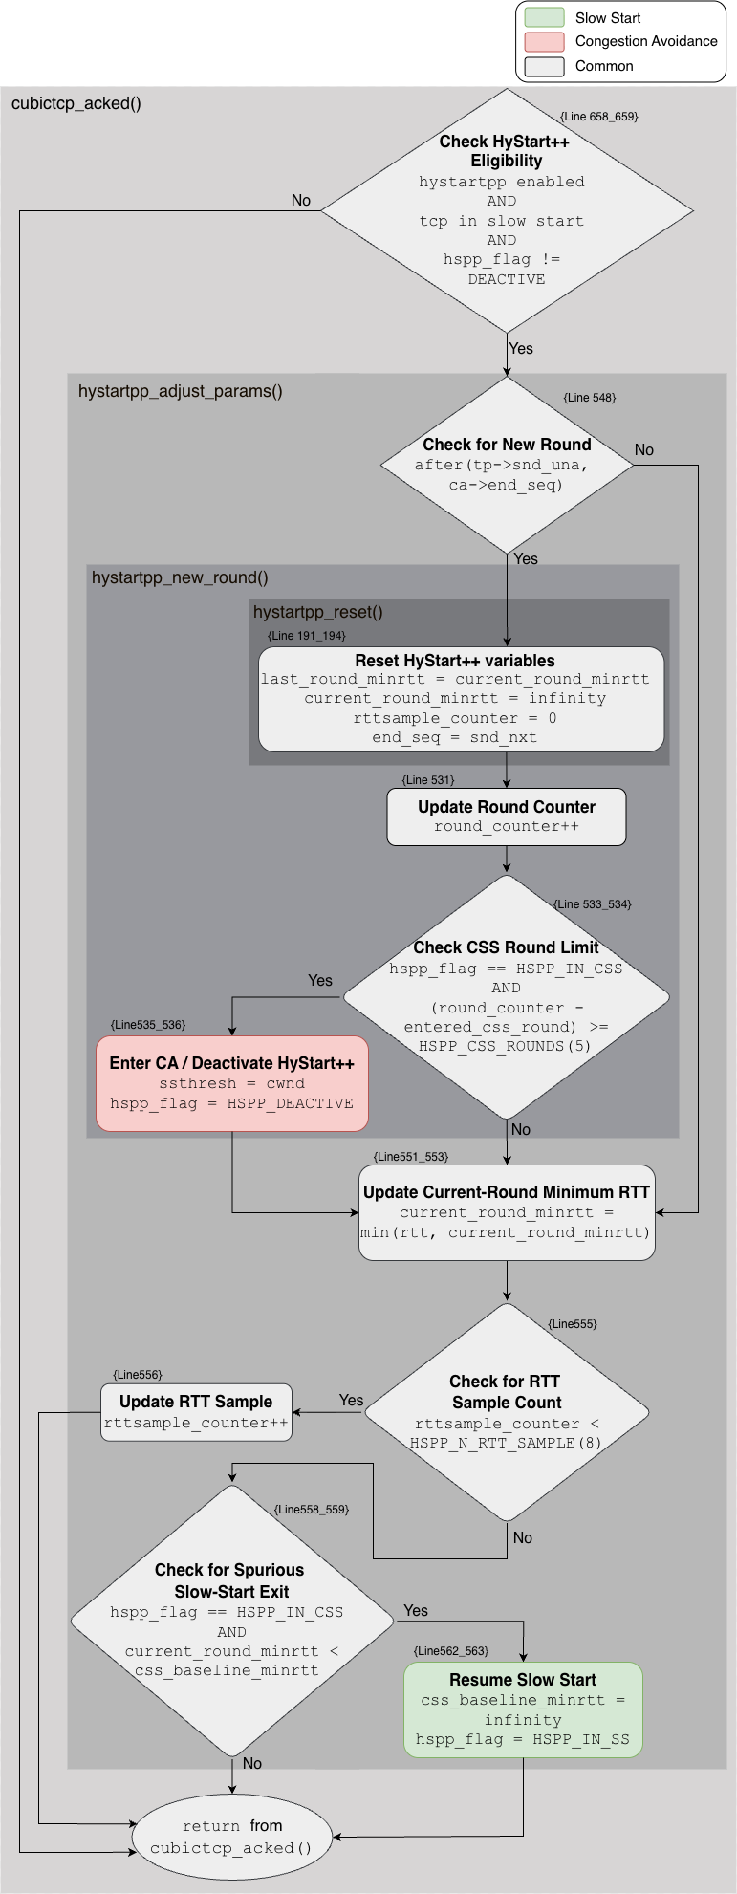
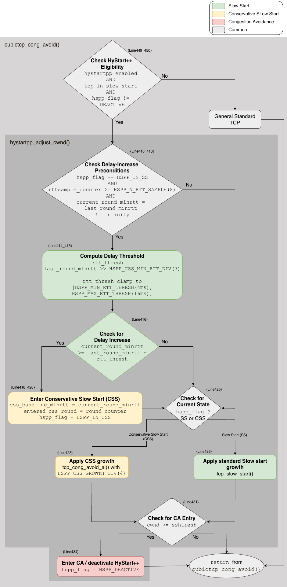
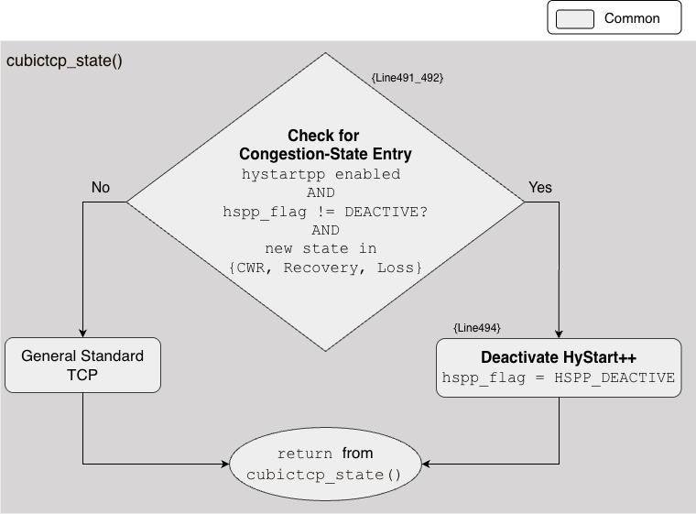
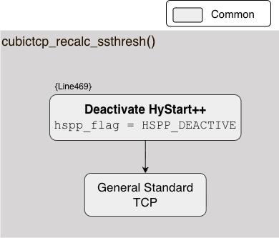
Linux Implementation
RTT / Rounds
cubictcp_acked() maintains RTT samples, round tracking, rollback to slow start, and exit slow start by completion round in CSS.
cwnd growth
cubictcp_cong_avoid() applies standard slow start or CSS growth and detects CSS entry.
deactivation
state and ssthresh callbacks deactivate HyStart++ after congestion events.

Slide 9
Paper Roadmap
1. RFC Flowchart
What HyStart++ is intended to do
2. Linux Paths
Where that behavior appears
3. Validation Summary
Match
4. Evaluation
Controlled + GEO testbeds
5. Conclusion and future works

Slide 10
Functionality Match
RFC behavior RFC | RFC flowchart state | Linux implementation function
Initialize minimum RTT values and round boundary | Initialize HyStart++ Variables | cubictcp_init(), hystartpp_reset()
Start a new round and reset per-round measurements | Check for End of Round; Start New Round | cubictcp_acked(), hystartpp_adjust_params(), hystartpp_new_round(), hystartpp_reset()
Update current-round RTT measurements | Update cwnd and minRTT (RTT-update portion) | cubictcp_acked(), hystartpp_adjust_params()
Detect delay increase and enter CSS | Check for Delay-Increase Preconditions; Compute Delay Threshold; Check for Delay Increase; Remain in Slow Start; Exit Slow Start and Enter CSS | cubictcp_cong_avoid(), hystartpp_adjust_cwnd()
Apply slow start and CSS growth | Check for Current State; Update cwnd and minRTT (cwnd-update portion) | cubictcp_cong_avoid(), hystartpp_adjust_cwnd(), tcp_slow_start(), tcp_cong_avoid_ai()
Return from CSS after a spurious slow start exit | Check for CSS Sample Requirement; Check for Spurious Slow-Start Exit; Resume Slow Start | cubictcp_acked(), hystartpp_adjust_params()
Complete CSS and enter congestion avoidance | Check for CSS Completion; Remain in CSS; Enter Congestion Avoidance | cubictcp_acked(), hystartpp_adjust_params(), hystartpp_new_round()
Handle loss or ECN during slow start or CSS | Check for Congestion Signal; Enter Congestion Avoidance | cubictcp_state(), cubictcp_recalc_ssthresh()
Restrict HyStart++ to the initial slow start | Enter Congestion Avoidance | cubictcp_init(), hystartpp_new_round(), hystartpp_adjust_cwnd(), cubictcp_state(), cubictcp_recalc_ssthresh()

Slide 11
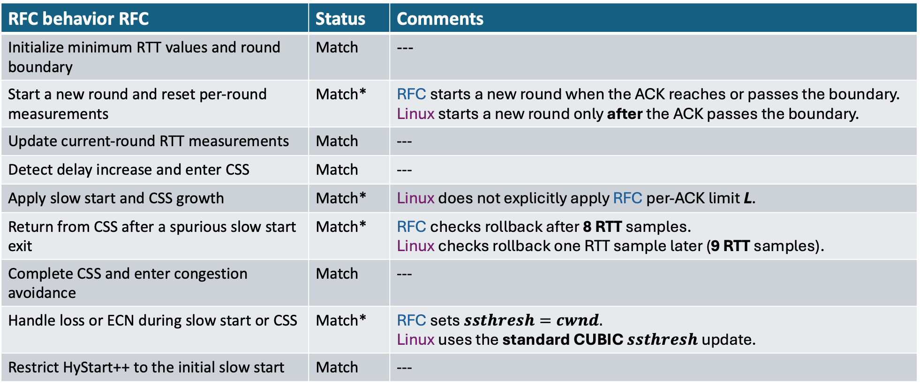
Functionality Match
RFC behavior RFC | Status | Comments
Initialize minimum RTT values and round boundary | Match | ---
Start a new round and reset per-round measurements | Match* | RFC starts a new round when the ACK reaches or passes the boundary. Linux starts a new round only after the ACK passes the boundary.
Update current-round RTT measurements | Match | ---
Detect delay increase and enter CSS | Match | ---
Apply slow start and CSS growth | Match* | Linux does not explicitly apply RFC per-ACK limit L.
Return from CSS after a spurious slow start exit | Match* | RFC checks rollback after 8 RTT samples. Linux checks rollback one RTT sample later (9 RTT samples).
Complete CSS and enter congestion avoidance | Match | ---
Handle loss or ECN during slow start or CSS | Match* | RFC sets $ssthresh=cwnd.$ Linux uses the standard CUBIC $ssthresh$ update.
Restrict HyStart++ to the initial slow start | Match | ---

Slide 12
Paper Roadmap
1. RFC Flowchart
What HyStart++ is intended to do
2. Linux Paths
Where that behavior appears
3. Validation Summary
Match
4. Evaluation
Controlled + GEO testbeds
5. Conclusion and future works

Slide 13
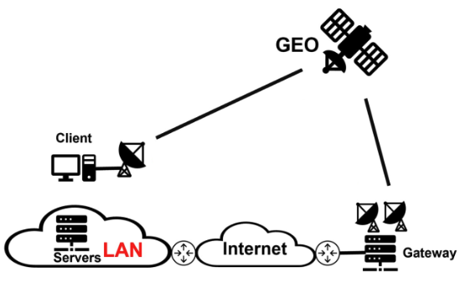

Evaluation Testbeds
Controlled testbed
GEO testbed
server
Host router
(Raspberry Pi)
client
Factor | Value
Algorithm | Traditional, HyStart, HyStart++
Rate | 50, 100, 150 Mb/s
Base RTT | 25, 100, 400 ms
Queue | 1, 2, 4 X BDP
Jitter | RTT/4, RTT/2, RTT
Duration | 10 seconds
Runs | 30 per config; 2,430 per algorithm
Factor | Value
Algorithm | Traditional, HyStart, HyStart++
Duration | 45 seconds
Schedule | 24 hours
Runs | 161 per algorithm

Slide 14
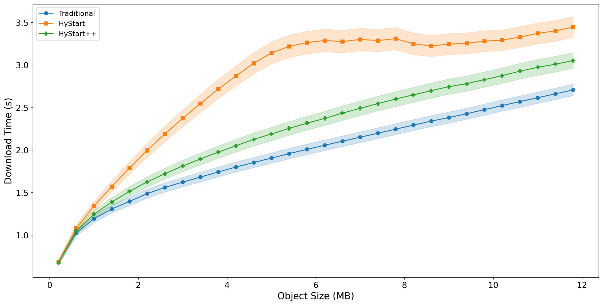
Evaluation Result: Download Time
Controlled dataset

Slide 15
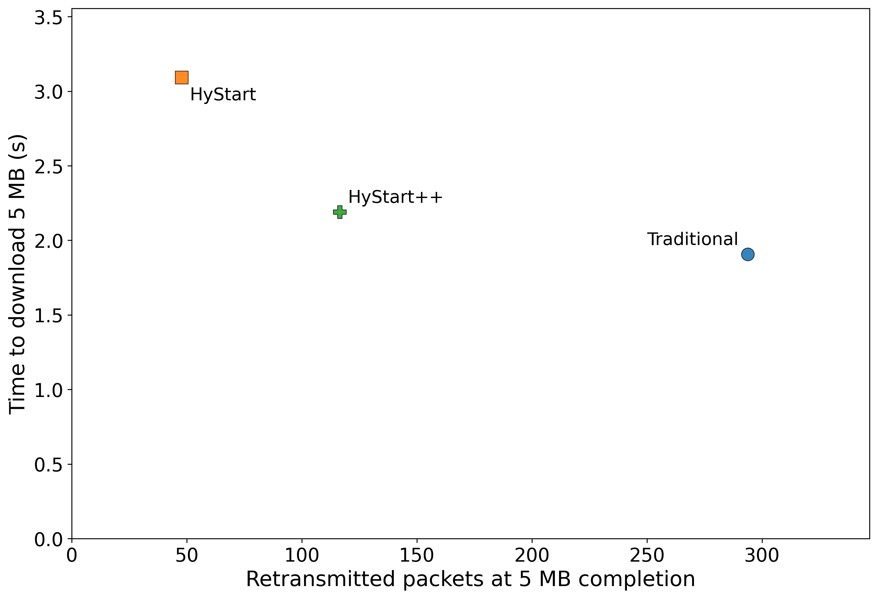
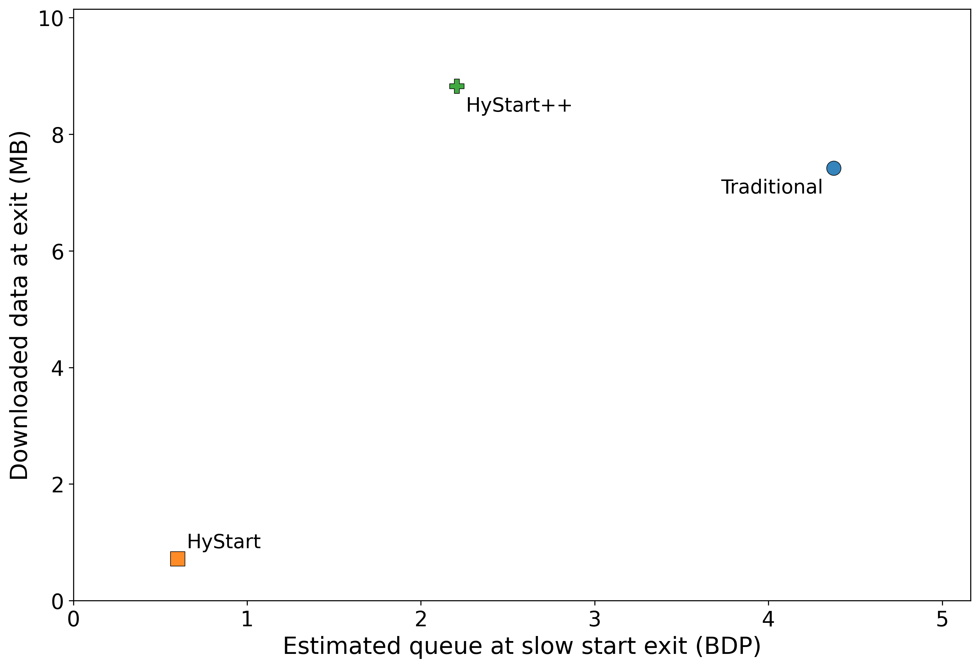
Evaluation Result
Controlled dataset
Mean time to download 5 MB versus retransmitted
packets at 5 MB completion
Downloaded data and estimated queue occupancy
when the slow start exit has happened

Slide 16
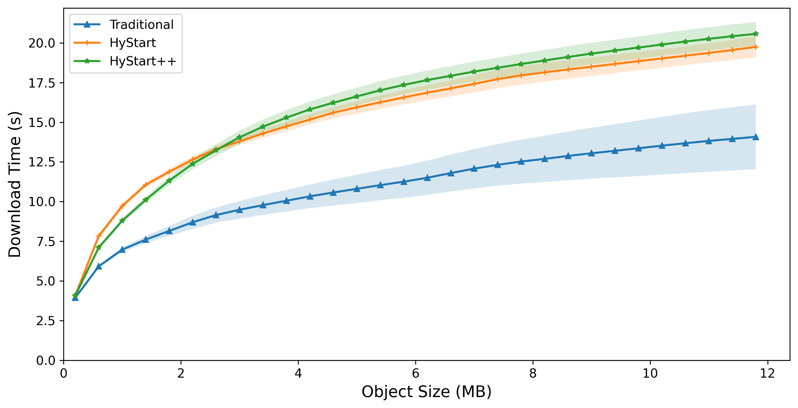
Evaluation Result: Download Time
GEO dataset
SEARCH
M. A. Kachooei et al., “Implementation of the SEARCH Slow Start Algorithm in the Linux Kernel,” Proc. NetDev 0x18, 2024.

Slide 17
Paper Roadmap
1. RFC Flowchart
What HyStart++ is intended to do
2. Linux Paths
Where that behavior appears
3. Validation Summary
Match
4. Evaluation
Controlled + GEO testbeds
5. Conclusion and future works

Slide 18
Conclusion
Linux HyStart++ faithfully implements the main RFC 9406 behavior:
Slow Start → CSS → Congestion Avoidance
CSS reduces premature HyStart exits by probing after the first delay signal.
HyStart++ is a middle point:
less conservative than HyStart, less aggressive than traditional slow start
RTT variation still challenges delay-based exit on wireless/satellite paths.

Slide 19
Future Work
Tune HyStart++ parameters for high-variation paths:
CSS duration, CSS growth rate, delay threshold
Explore delivery/rate-based signals for slow start exit:
  RTT-confirmed signal
  Standalone signal

Slide 20
Validation and Evaluation of HyStart++ for Linux
Thank you for your attention!
Maryam Ataei Kachooei
Clive Thompson
Zimraan Ahmad
Joshua Solomon
Mark Claypool
15 July, 2026
Jae Chung
Feng Li
Benjamin Peters

