Slide 1
Host-pluggable RDMA Congestion Control
Vivek Kashyap
vivek.kashyap@intel.com

Slide 2
Programmable Congestion-control
RDMA congestion control is fixed-function in the NIC
Move congestion control into a host-accessible, pluggable control framework
  Enable algorithms to be prototyped, tuned, compared, and evolved without requiring firmware or hardware changes.
  Support policy-specific congestion behavior for AI/ML, storage, HPC, KV-cache movement, and front-end traffic.
Identify the minimal endpoint interfaces needed for signal gathering, algorithm execution, and rate/CWND enforcement.
Consider a generic framework on Linux for programmable RDMA CC

Slide 3
Congestion control loop
A general congestion loop
  Input signals -> congestion algorithm -> output constraints
  Per flow or per congestion context
Congestion Context
CC algo
CC Algorithm
Programmable
CC Algorithm
CC Algorithm
Control output
Signal matrix
ECN
DELAYLOSS INT
TRIM
RATE
CWND
RDMA NIC

Slide 4
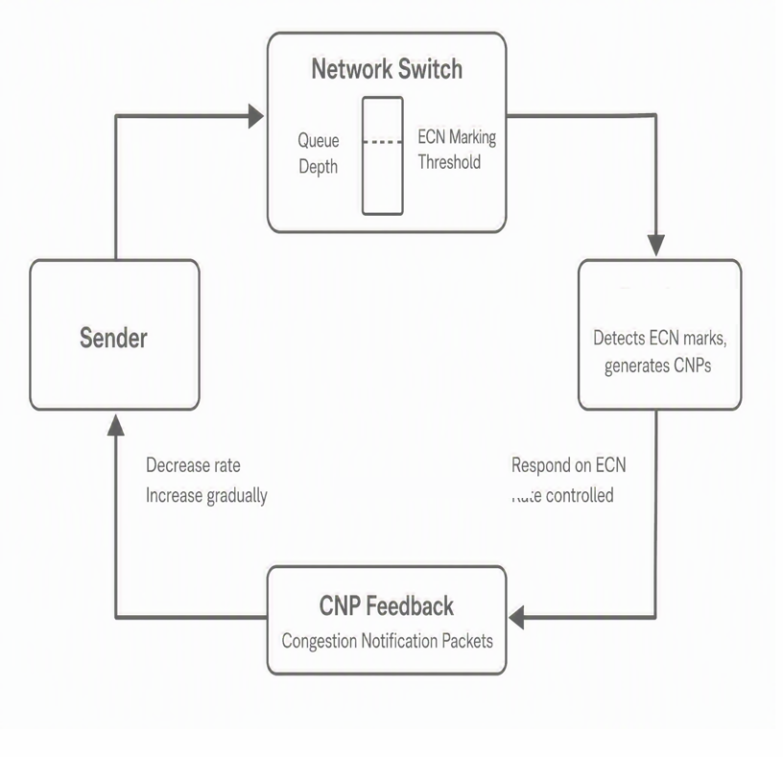
Example: DCQCN
DCQCN is a rate-based congestion-control algorithm embedded in the RNIC
Switch ECN-marks, the destination RNIC detects and sends Congestion Notification Packets (CNPs) back to the source
The source RNIC uses CNP feedback to estimate congestion and set the new rate.
DCQCN is commonly deployed with PFC in RoCEv2 fabrics

Slide 5
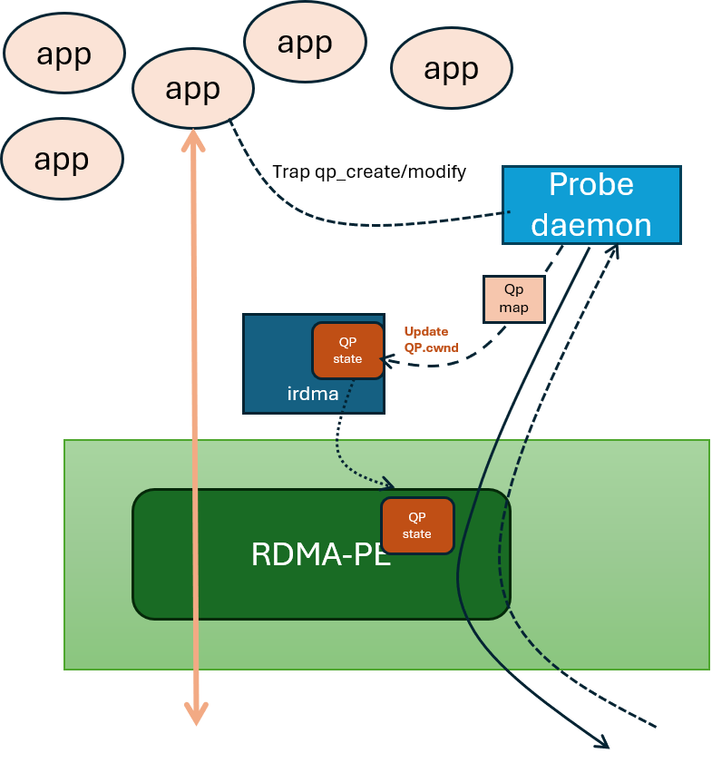
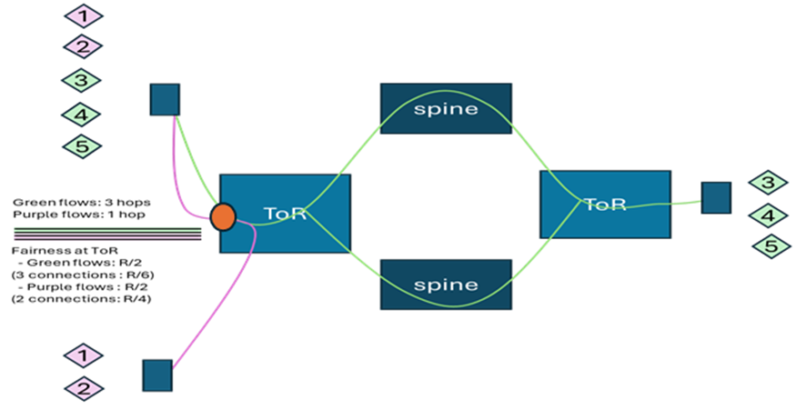
pRTT
Recv deamon
RDMA-PE
QP
state
Common signals for a context
Probes sent on a special QP or on LAN
  Hardware timestamps
  - depends on hardware capabilities
No PFC, no ECN, no CNPs
Determine QP membership
  Get signals per Congestion context (QP set)
Calculate CWND
For each QP member
  Proportional rate update through the driver

Slide 6
probe RTT (pRTT): userspace RDMA CC
CC control loop | pRTT (user space congestion mgmt.) | DCQCN (Fixed function congestion mgmt.)
Congestion Context | QPs to same destination | QP
Signal Matrix | RTT | ECN
Input source | probe response h/w timestamp | CNPs
Congestion algorithm | Delay compared to target delay | DCQCN – responds to CNPs
CC output | Proportionally applied to QPs | Rate control on QP
Control method | Driver writes to QP state | Internal state updated within RNIC
Network | lossy | lossless

Slide 7
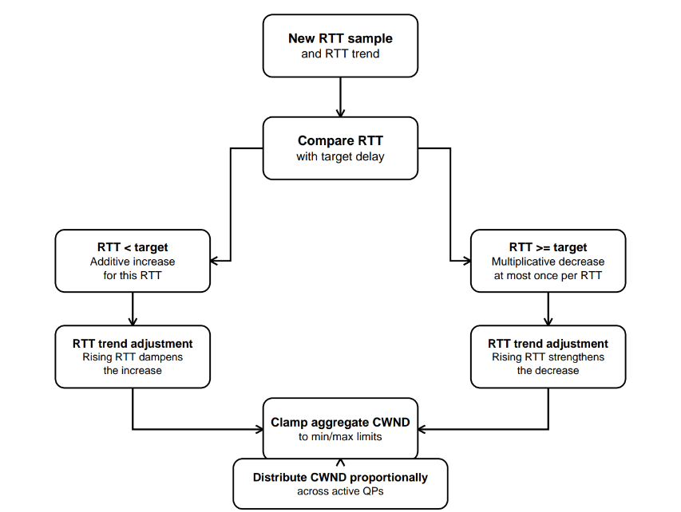
Algorithm: Calculate CWND
Input: One probe-measured RTT and RTT trend per control interval (Gradient)
Below target: Additive increase
At/above target: Multiplicatively decrease, limited to once per RTT
Trend adjustment: Rising RTT dampens increase or strengthens decrease
Output: Clamp aggregate CWND and distribute it proportionally across active QPs

Slide 8
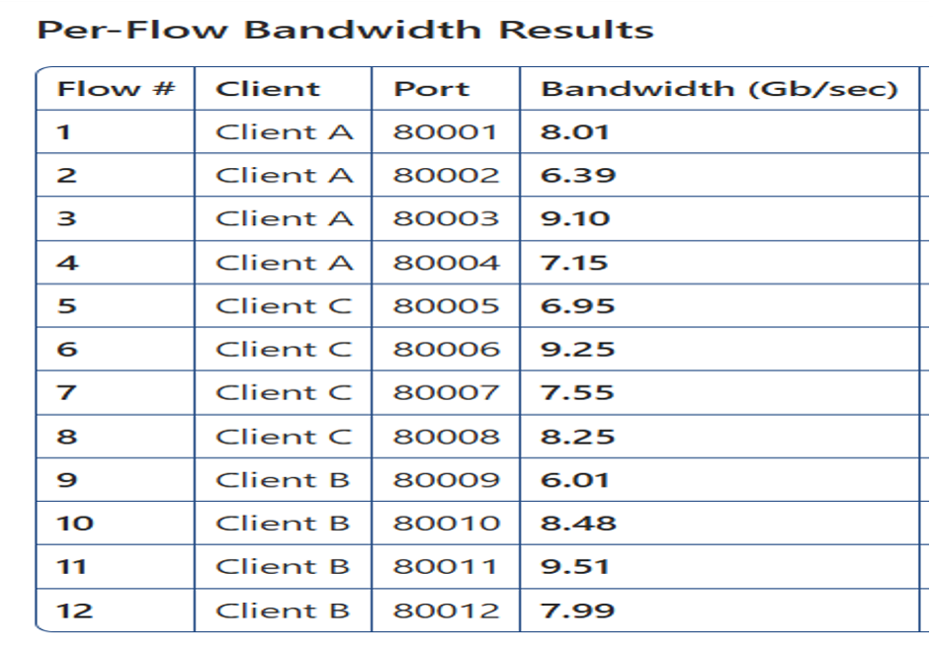
pRTT 3*4 : 1 Incast
Individual flows vary due to start and QP write latencies
Per client aggregate is fair (approximately) – 30Gbps

Slide 9
From Prototype to Framework
Prototype disables NIC-embedded CC. Uses special driver interfaces.
Linux framework should retain the control-loop structure while replacing prototype specific coupling.
  Basic control instance binds setup, congestion context, signal gatherer, algorithm, output applier.​
  The framework owns lifecycle, invocation, serialization, capability checks, and teardown.
  Each implementation owns its signal semantics and device-specific enforcement.
setup/config
|
congestion-control context
+-----------------------+-----------------------+
| | |
v v v
signal_gather() cc_algorithm() apply_output()
user/provider code user/provider code user/driver code
| | |
aggregated input -> rate / CWND -> QPs / QP set / NIC

Slide 10
signal_gatherer(): local and remote inputs
receiver host sender congestion context
+---------------------------+ +---------------------------+
| RNIC / driver statistics |-- cumulative --> | signal gatherer |
| ECN, CNP, loss, other | feedback | |
+---------------------------+ | probe RTT |
| local NIC counters
| INT |
local probe / events ------------------------->| remote daemon feedback |
| accumulate / correlate |
+-------------+-------------+
The gatherer owns acquisition, accumulation, smoothing, freshness, and publication rules.
Cumulative remote counters tolerate missed feedback
The gatherer computes interval deltas.

Slide 11
Gatherer-to-algorithm execution
Option 1: inline Option 2: worker thread
------------------------------- -------------------------------
gatherer has input gatherer publishes latest input
call algorithm directly signal algorithm pthread/workqueue
low handoff latency gatherer remains unblocked
algorithm must not block stale inputs are coalesced
cc_algorithm(context, input, state) -> { no change | CWND | rate }
|
Output-> write to QP state
The framework supports one serialized algorithm invocation per context
The gatherer receives raw events, and the algorithm receives one gatherer-prepared input.
The algorithm is never invoked while the gatherer holds its update lock.
Notes:
[

Slide 12
Framework mediated inputs
Prototype uses modified driver and codes to it
Possible extensions
  driver_ops->get_signals(device, scope, requested_signals, &snapshot);
    Signals matrix to be defined
  driver_ops->apply_control(device, qp_set, PCC_CONTROL_CWND/RATE, value);

Slide 13
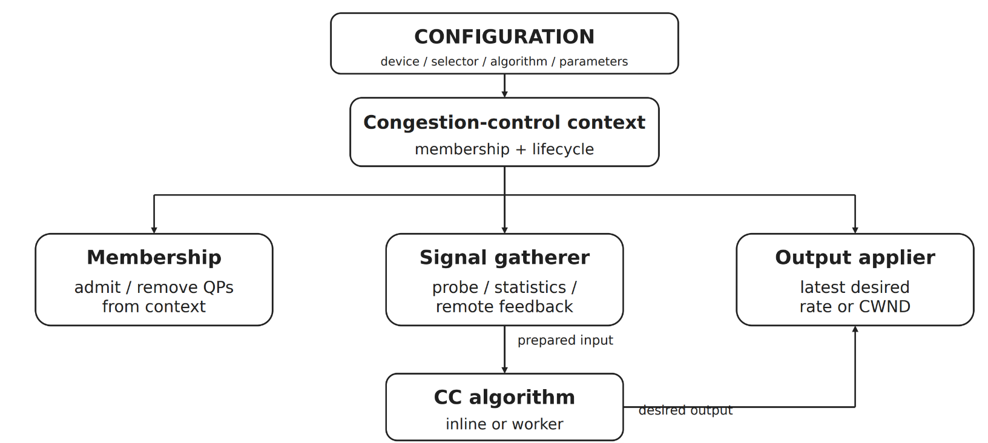
Exampe: pRTT as framework specification
Framework element | pRTT composition
setup/config | disable embedded CC; configure peers/NIC
context membership | QPs associated with destination
signal_gather | timestamped active probe
prepared input | RTT sample and metadata
algorithm state | srtt, gradient, target delay, aggregate CWND
algorithm | delay/trend controller
output | aggregate context CWND
apply_output | distribute and program per-QP CWND

Slide 14
Five ways to package framework
Built into one daemon​
  Simplest first implementation; direct function calls.​
Userspace shared-object plugins (.so)​
  Load named components at startup with dlopen()/dlsym().​
​
Separate daemons or services​
  Process isolation: IPC, lifecycle, and latency cost.​
Kernel built-in code or loadable modules (.ko)​
  Close to QP lifecycle and driver events
eBPF algorithm programs​
  Dynamic verified policy, still needs context, inputs, helpers, and outputs

Slide 15
Example Framework Packaging with pRTT
int main(int argc, char **argv)
{
framework_init(); load_builtin_components(); load_plugins();
load_configuration();
create_configured_contexts();
framework_run();
framework_shutdown();
}
Context selection​
membership = "destination-qps"​
signal = "probe-rtt"​
algorithm = "prtt"​
output = "irdma-qp-cwnd"​
​
Plugin responsibilities​
probe-rtt: probe path, calculate RTT
prtt: RTT/trend, return aggregate CWND​
irdma-qp-cwnd: obtain current members;
distribute/program CWND​
Illustrative plugin descriptor
struct pcc_plugin_descriptor {​
uint32_t abi_version;​
const char *plugin_name;​
​
const struct pcc_membership_ops *membership_ops;​
const struct pcc_signal_ops *signal_ops;​
const struct pcc_algorithm_ops *algorithm_ops;​
const struct pcc_output_ops *output_ops;​
};​
​
Example: .so based plugin
PCC daemon startup​
|​
+-- dlopen("libpcc_probe_rtt.so")​
| -> signal ops: "probe-rtt"​
|​
+-- dlopen("libpcc_prtt_algo.so")​
| -> algorithm ops: "prtt"​
|​
+-- dlopen("libpcc_irdma_cwnd.so")​
-> output ops: "irdma-qp-cwnd"​
​
Configuration selects registered names - not function addresses.​
​

Slide 16
Questions
Vivek.Kashyap@intel.com

Slide 17
backup

Slide 18
Practical Congestion Control Signals
Network Signals
Loss: TCP Cubic, Reno
  AIMD response
Notification: DCTCP, DCQCN
  ECN – receiver sends feedback to sender. Rate control
Delay: Swift, TCP Vegas, TIMELY
  Lagging indicator of congestion
  RTT and Rate control
  Swift: pacing for incast
Switch signals
ECN: AQM – at egress
  Leading indicator of congestion
INT: HPCC
  Get network information
  Queue length, transmitted bytes
  Link capacity, timestamp

