Slide 1
MOONSHOT TRACK · NETDEV 0x1A
Why Syscalls Fail
Bilateral Commit at the Linux Kernel/Userspace Boundary
Manav Singhai
Measurements & Findings
Paul Borrill
Framework & Argument · DÆDÆLUS
Università Roma TRE · 13–16 July 2026

Slide 2
TALK STRUCTURE
Two speakers, one argument
PB
Paul Borrill
MS
Manav Singhai
Framework & argument
Measurements & findings
The page-cache illusion & FITO
The Kernel Acknowledgment Spectrum
Forensic case studies (fsync, io_uring, fork, signals)
Existing bilateral mechanisms & the proposal
Linux 6.8 test harness (E1–E4, R1)
Quantitative silent-loss rates
The Bilateral Commit Queue shim
What the numbers say about the Spectrum
Closing: joint Q&A
2

Slide 3
MOTIVATION
write() is a lie
PB
The kernel copies data into the page cache and reports success.
That is not durability — it's volatile memory.
The caller assumes forward progress. The kernel makes no commitment.
write()
page cache
I/O error
fsync() retry
→
→
→
dirty page,
returns “ok”
volatile,
not on disk
kernel clears
error flag
returns 0
(false success)
“Written”
PostgreSQL vs. ext4, 2018
calls an operation that has written nothing durable. The interface lies, and the programmer believes the lie.
A disk I/O error clears fsync()'s error flag after one report. On retry, fsync() returns success — data is gone, PostgreSQL believes the WAL is durable.
3

Slide 4
THE PATTERN
The same structural hole, four times over
PB
1
2
3
4
Email
Messaging
Ethernet
Syscalls
SMTP
SMS / iMessage
conventional L2
write / send / fork
relay confirms transport,
not that the recipient read it
“Delivered” confirms silicon,
not a mind
frame transmitted ≠
frame delivered
kernel receipt ≠
kernel commitment
FITO — Forward-In-Time-Only: every one of these assumes that once an operation is initiated, time will carry it forward to completion.
4

Slide 5
THE FRAMEWORK
The Kernel Acknowledgment Spectrum
PB
4
3
2
1
0
Fire-and-Forget
Kernel Receipt
Completion Notification
Application Consumption
Bilateral Semantic Commit
write() to page cache
w/o fsync()
write(), send()
return a count, not durability
fsync(), io_uring CQEs
io_uring_cqe_seen(),
userfaultfd
no general-purpose
syscall reaches this
5

Slide 6
THEOREM
Most syscalls cap at Level 1
PB
Mechanism | Elevates | Level
fsync(fd) | write() durability | 2
io_uring_cqe_seen() | I/O completion consumption | 3
userfaultfd | page fault resolution | 3
O_SYNC / O_DSYNC | write() durability | 2
Lₘₐₓ(F) ≤ 1
for F ∈ {write, read, send, recv, mmap, fork, brk}
No mechanism reaches Level 4 — the kernel never learns whether the application actually verified the result.
No bolt-on mechanism reaches Level 4.
6

Slide 7
TAXONOMY
Four families, one structural weakness
PB
write() / fsync()
io_uring
PostgreSQL vs. ext4 (2018): error flag cleared after one report; retry fsync() lies.
Completion queue entries can be silently overwritten before userspace reads them.
fork()
Signals
OOM killer can end a child before the parent's PID is even schedulable.
SIGCHLD coalesces: three children exit, one signal arrives. The kernel knows; it doesn't tell.
7

Slide 8
MS
MEASUREMENTS & FINDINGS
Is the Spectrum measurable on real Linux?
Four reproducers and one remedy, run on Linux 6.8.0 / aarch64
Presented by Manav Singhai

Slide 9
METHODOLOGY
The harness
MS
Ubuntu 24.04 / Linux 6.8.0, aarch64
Lima/Vz virtualization on Apple M2
io_uring FEAT_NODROP active
Each reproducer logs JSON Lines, aggregated by harness/aggregate.py
E1
fsync() error-clear
dm-flakey fault injection
E2
io_uring CQE overrun
N = 16 → 1024 nops
E3
SIGCHLD coalescing
N = 2 → 256 children
E4
fork()/OOM stale-PID race
64 MiB cgroup-v2 leaf
R1
Bilateral Commit Queue shim
≈100-line liburing wrapper
9

Slide 10
E1 · FSYNC() ERROR-CLEAR
fsync() lies after the first report
MS
50/50 trials: the retry fsync() returned 0 while the block was absent from disk — in every single trial.
100%
100%
error_writes
(25 trials)
drop_writes
(25 trials)
Read-back used O_DIRECT after drop_caches, so the cached page couldn't mask on-disk loss. No 6.8 mitigation exists — the same bug as 2018.
Level 1 masquerading as Level 2: report-once-then-forget error semantics violate the bilateral contract.
10

Slide 11
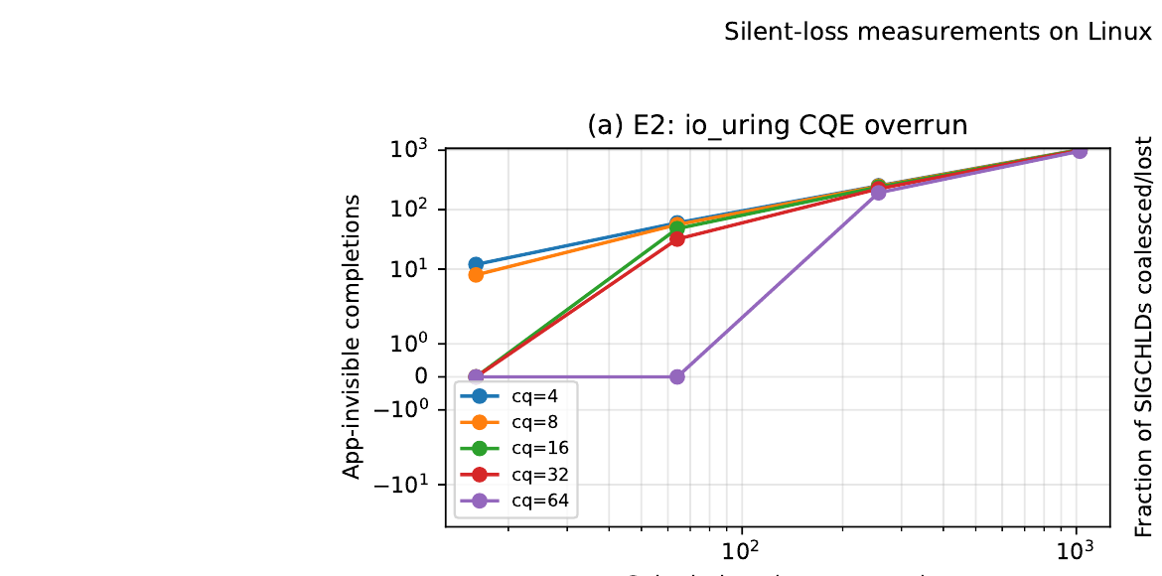
E2 · IO_URING CQE OVERRUN
Completions the application never sees
MS
16 of 20 cells
show strictly fewer completions than submitted.
1,008 / 1,024
completions held invisibly in the kernel overflow list at cq=16, N=1024
Figure 1(a): app-invisible completions vs. submissions, per CQ size
FEAT_NODROP routes overflow to a kernel-side list instead of dropping it — but the application still has no syscall-level signal that state is accumulating.
11

Slide 12
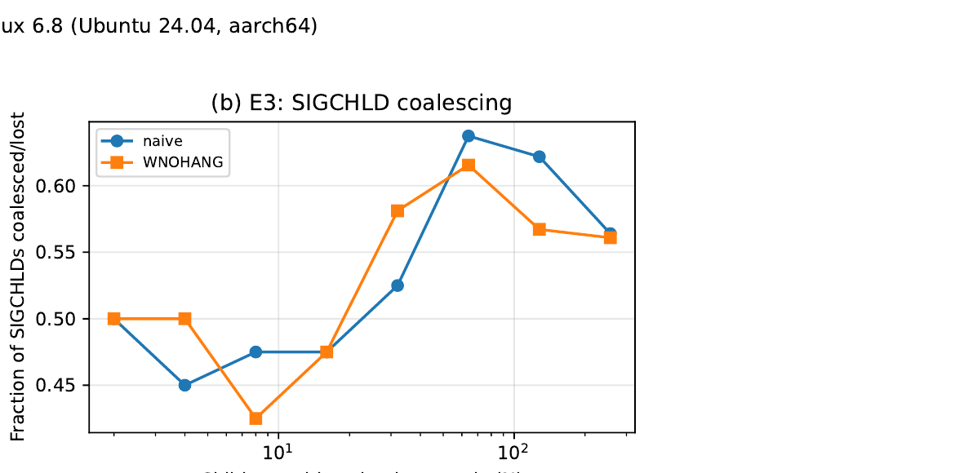
E3 · SIGCHLD COALESCING
One signal for three exits
MS
36–153
SIGCHLDs delivered for 256
simultaneous exits (median 130)
0.5–0.8
coalesced-loss fraction
at N = 256
Figure 1(b): fraction of SIGCHLDs coalesced/lost vs. simultaneous exits
A robust WNOHANG loop reaps all children — but that's the application compensating. The kernel still chose to deliver one signal, knowing three exited.
12

Slide 13
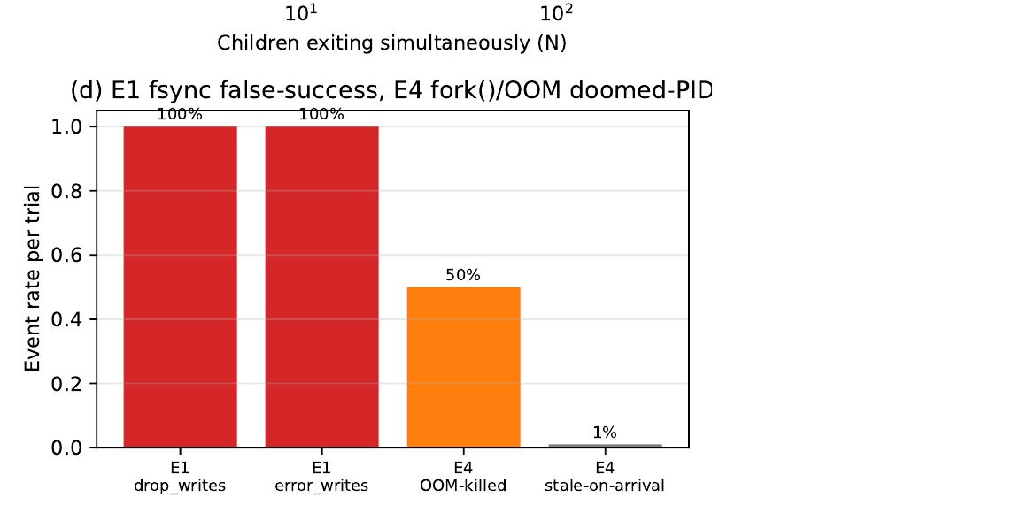
E4 · FORK()/OOM STALE-PID RACE
A PID for a process that's already dead
MS
7.7 ms
median fork-to-terminal time — the child never executed a single instruction of useful work.
100%
50 / 50 trials
child SIGKILLed by the OOM-killer in a 64 MiB cgroup-v2 leaf
fork() returns a valid PID as a forward-time projection of viability — the kernel has no protocol to retract it once the OOM killer acts.
Figure 1(d): E1 & E4 event rates
13

Slide 14
R1 · THE REMEDY
Making silent CQE loss structurally impossible
MS
A ~100-line userspace shim wraps liburing with a per-process Commit Queue: it refuses submissions that would overcommit the CQ, and advances the kernel-visible head only on commq_commit().
Path | Silent loss | Rate | Overhead
Naked (no cqe_seen) | 21,280 | 80% of cells | —
Correct (cqe_seen) | 0 | 0% | baseline
CommQ shim | 0 | 0% | +39%
The shim can't exceed the ring's Level-2 device ceiling, but it raises the application-facing interface to Level 3 — refusing to overcommit, rather than dropping or hiding completions.
14

Slide 15
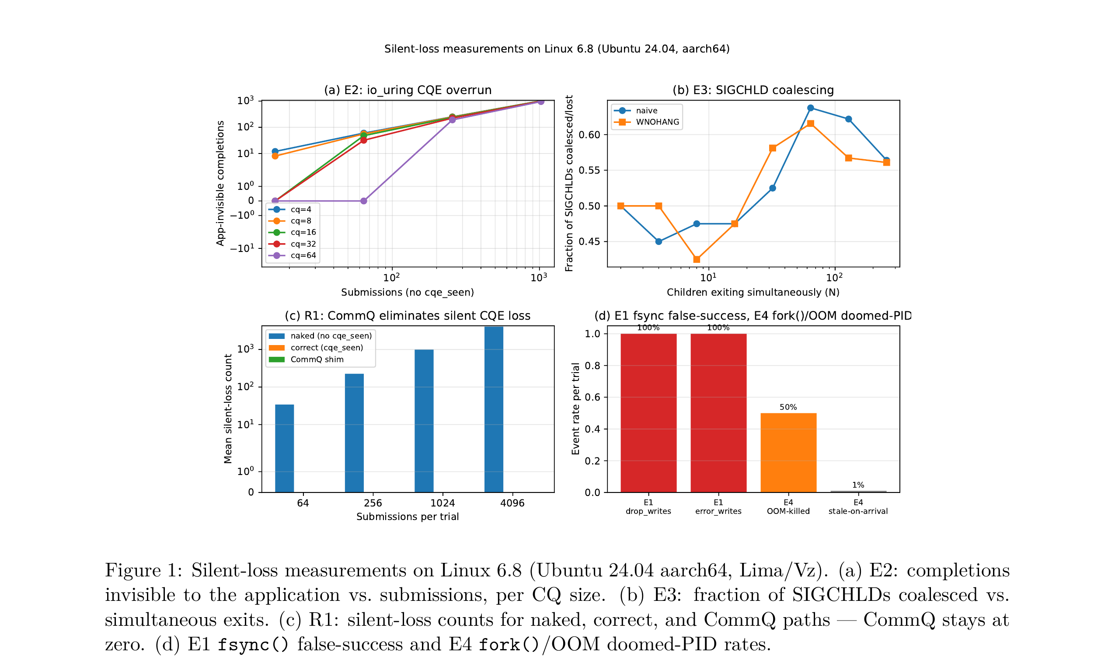
FIGURE 1
All four measurements, together
MS
15

Slide 16
TAKEAWAYS
MS
The Spectrum isn't theoretical — it's measurable, and current
100%
1,008
80%
100%
false fsync() durability across 50 trials
silently buffered io_uring completions in a single ring
SIGCHLD loss at modest concurrency
doomed-PID forks into a constrained cgroup
On Linux 6.8 / aarch64, over 3–25 trials per cell (E1: 25/mode; E2/R1: 5/cell over 20/16 cells; E3: 5/(N,mode); E4: 50).
The forensic record and the measured rates make bilateral syscall semantics practically necessary — not just theoretically desirable.
16

Slide 17
BACK TO THE FRAMEWORK
The Kernel Cognition Gap
PB
R(O) ⇏ A(O)
The messaging Cognition Gap, one layer down
R(O): the kernel's delivery of a result (a value in rax, bytes in a buffer, a CQE)
A(O): the application's consumption and validation of it
WhatsApp's “Delivered”
confirms data reached silicon, not a mind.
A syscall return
confirms data reached a register, not application logic.
No kernel mechanism below the application layer can close the gap — A(O) is outside the kernel's system boundary.
17

Slide 18
PRIOR ART
Who has tried this before?
PB
Mechanism | Approach | Level
seL4 synchronous IPC | kernel blocks sender until receiver calls Recv() | 3
POSIX fsync() | bolt-on; error reporting is unilateral (report once, clear) | 2
Linux userfaultfd | genuine bilateral handshake for page-fault resolution | 3
Windows TxF | kernel-enforced atomic transactions — deprecated in Win 8 | 4*
The TxF Paradox: the highest-safety mechanism was too complex for humans to use correctly — the API must be simple enough to use correctly, or bilateral semantics become dead code.
18

Slide 19
THE PROPOSAL
A four-phase bilateral protocol
PB
1
2
3
4
Propose
Execute
Offer
Commit / Rollback
→
→
→
userspace submits;
kernel returns a transaction handle
kernel performs the operation;
failure reported via the handle
result placed in a buffer,
remains uncommitted
application validates and signals;
kernel finalizes or reclaims
Pipelined, not doubled: the COMMIT for operation n bundles with the PROPOSE for n+1 — one extra kernel crossing per sequence, not per syscall.
19

Slide 20
GETTING THERE
Three paths, increasing ambition
PB
1
2
3
O_BILATERAL flag
Bilateral io_uring
Bilateral microkernel IPC
opt-in bilateral semantics on write()/read() for a given fd. Analogous to O_SYNC — no change for apps that don't opt in.
a Commit Queue (CommQ) alongside SQ/CQ. The kernel doesn't reuse a CQE slot until the app writes a commit/rollback entry.
adopt seL4's synchronous IPC model for critical interactions, with pipelined commit to amortize latency.
Design principle: bilateral by default, opt-out for performance. seL4's synchronous IPC costs ≈ 0.2 µs per round trip on ARM64.
20

Slide 21
CONCLUSION
PB
A category mistake the kernel community can still fix
Treating kernel receipt as kernel commitment
is the mistake underlying PostgreSQL's lost transactions, io_uring's overwritten completions, and doomed forks into an OOM cgroup.
The question for Netdev
Does the kernel community recognise this category mistake before the next PostgreSQL-scale incident — or after?
The cost of fixing it is bounded: our CommQ shim reaches zero silent loss at ~39% overhead — a lower bound on what an in-kernel implementation could do.
21

Slide 22
Questions
MS
Manav Singhai
manavsinghai11@gmail.com
PB
Paul Borrill
paul@daedaelus.com
Netdev 0x1A · Università Roma TRE · 13–16 July 2026

